Slide 1
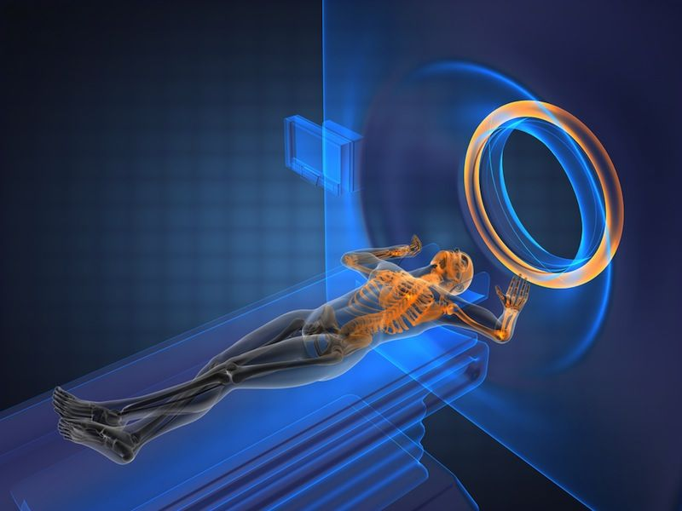
RECONSTRUCTING MRI IMAGES USING GANS
Aman Chopra, Nikhil D’ Souza

Slide 2
AGENDA
Background
Data
Implementation
Results
Next Steps
Notes:
Aman

Slide 3
BACKGROUND
01

Slide 4
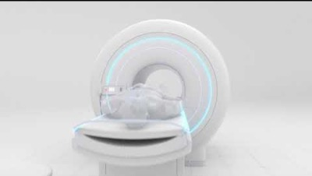
MOTIVATION
Notes:
Nikhil
Indexing adds a data structure with columns for the search conditions and a pointer
The pointer is the address on the memory disk of the row with the rest of the information
The index data structure is sorted to optimize query efficiency
The query looks for the specific row in the index; the index refers to the pointer which will find the rest of the information.
The index reduces the number of rows the query has to search through from 17 to 4.

Slide 5
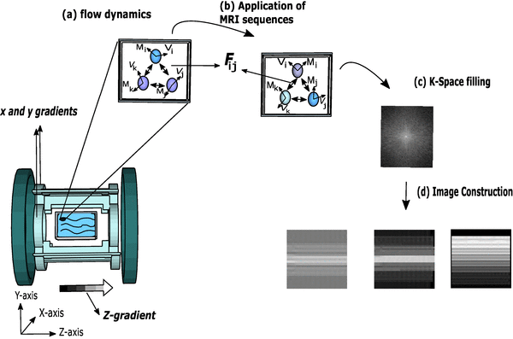
MRI BASICS
Notes:
Aman

Slide 6
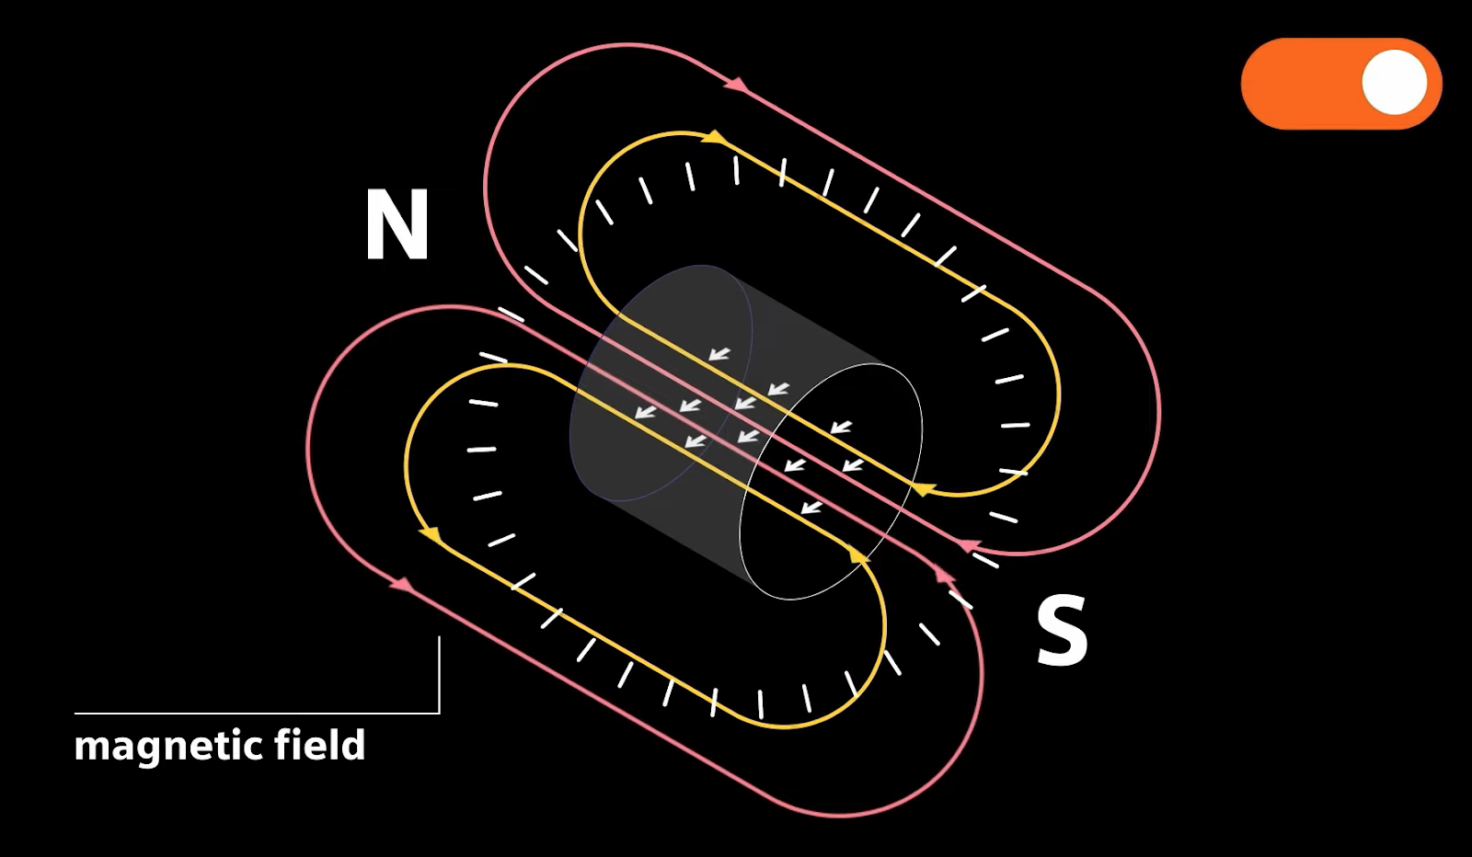
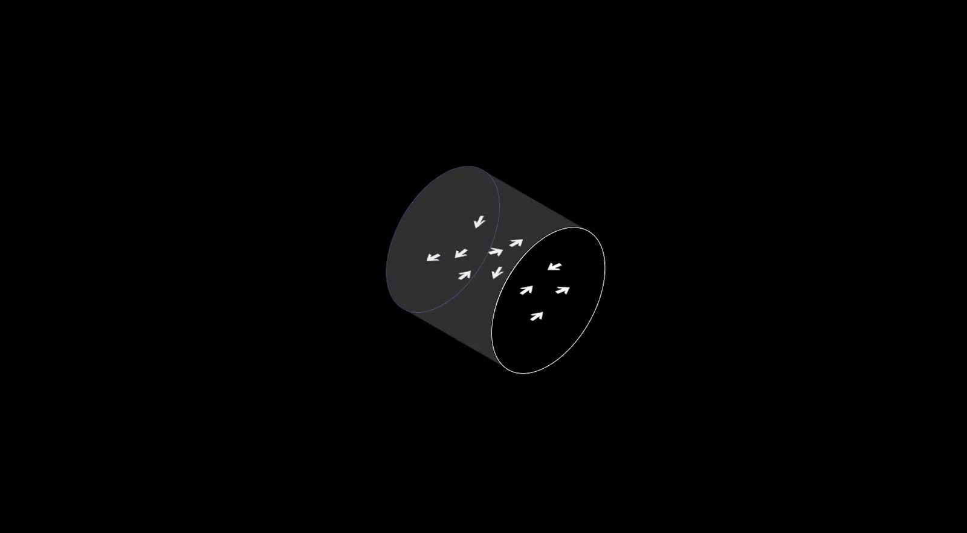
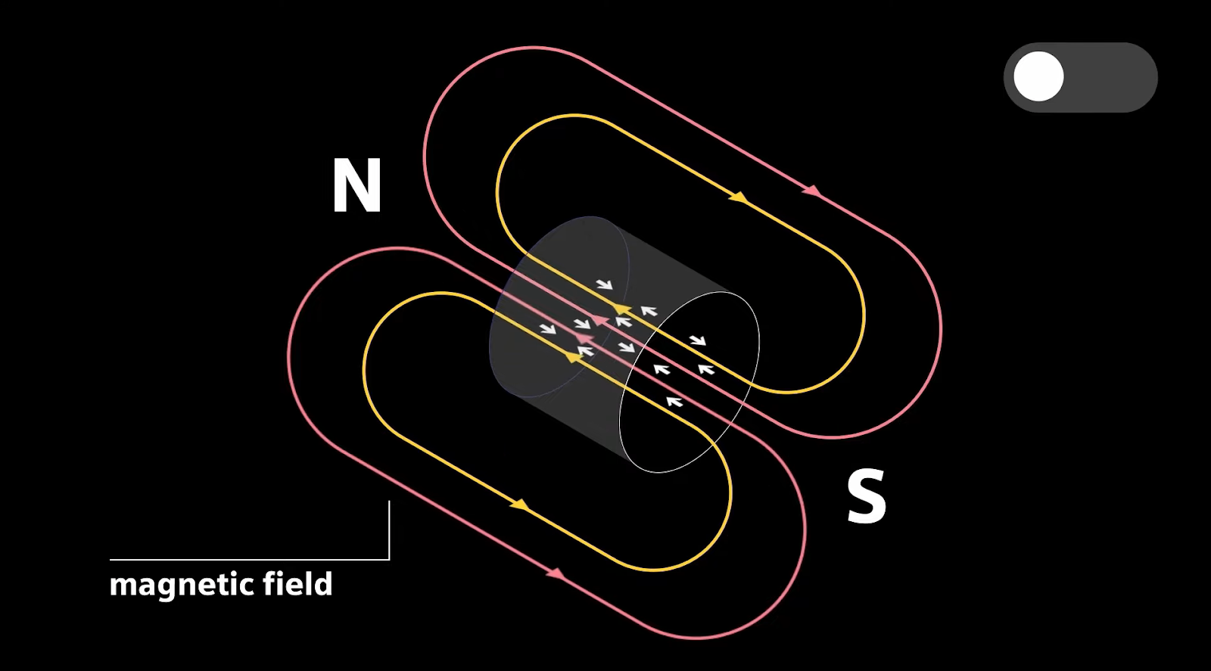
MRI BASICS: MAGNETISM
Notes:
Nikhil
ANIMATIONS ADDED TO SLIDE

Slide 7
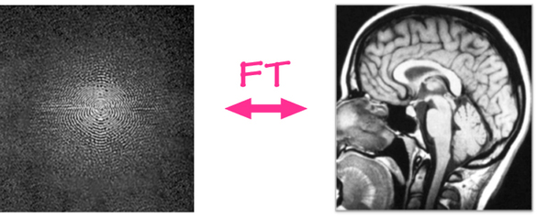
MRI BASICS: PRODUCING THE IMAGE
Notes:
Aman
k-space is an array of numbers representing spatial frequencies in the MR image. FT applies math transformations to convert from k-space to image we see.
Why do we care about this? Its important because our dataset is construct based on the fact that we can undersample the k-space to simulate images that would come out of fast-mri, as its trading off image quality with faster scan time.

Slide 8
DATA
02

Slide 9
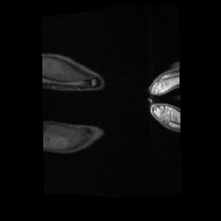
WE LEVERAGED THE MRNET DATASET FROM STANFORD’S ML GROUP.
Contains 1,370 knee MRI exams performed at Stanford Medical Center.
1,104 abnormal exams, with 319 ACL tears and 508 meniscal tears.
Notes:
Nikhil

Slide 10
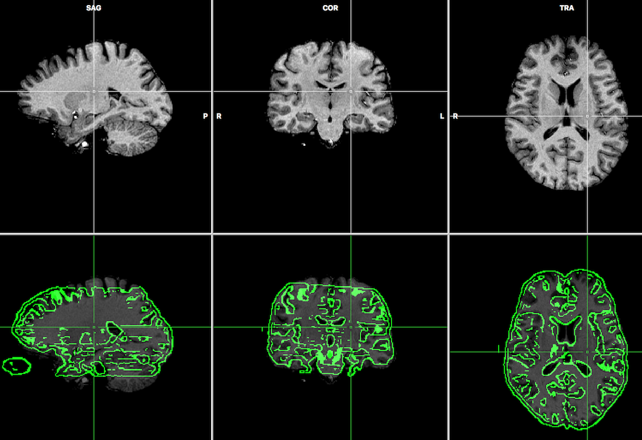
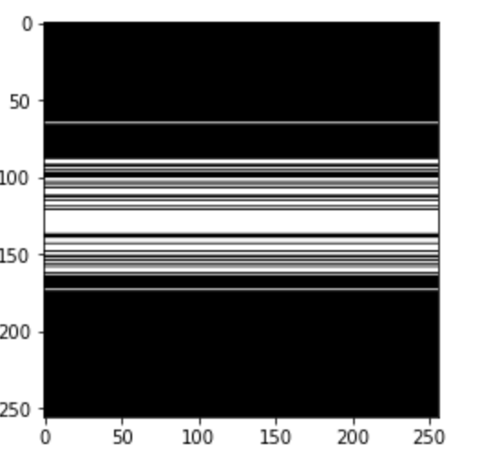
PREPROCESSING
Images in the nii.gz format processed with NiBabel library. Converted from 3D volumes to 2D slices.
Slices with # zero pixels / total # pixels > 15% dropped to limit size of dataset.
Undersampled image produced for each slice by conducting fourier transformation, undersampling in k-space, adding noise, and conducting inverse fourier transformation.
Stored data in pickle files for easy and consistent access when building models and testing.
Notes:
Aman
Undersampling conducted by multiplying a mask with the k-space. Mask was given and has non-zero pixel values in regions where original image features are most prominent.

Slide 11
MRI SLICE ANIMATION
Notes:
Nikhil
Undersampling conducted by multiplying a mask with the k-space. Mask was given and has non-zero pixel values in regions where original image features are most prominent.

Slide 12
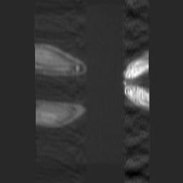
VISUALIZING THE UNDERSAMPLED IMAGES
Ground Truth
Undersampled
Notes:
Nikhil
Undersampling conducted by multiplying a mask with the k-space. Mask was given and has non-zero pixel values in regions where original image features are most prominent.

Slide 13
IMPLEMENTATION
03

Slide 14
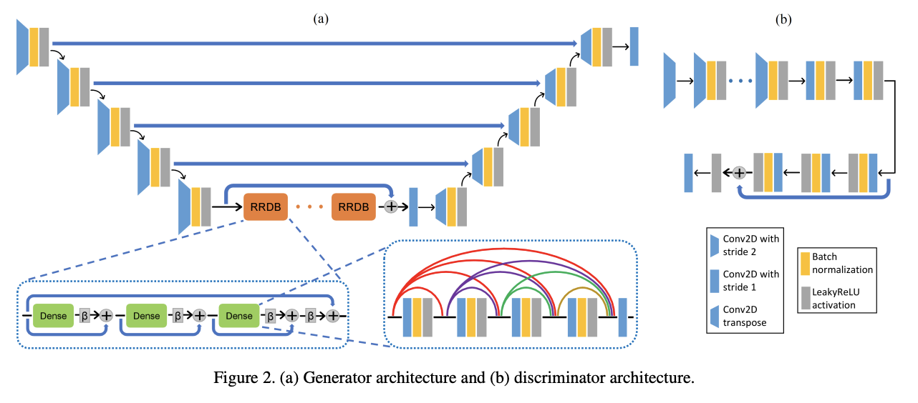
WE BUILT A GAN WITH THE BELOW ARCHITECTURE.
Notes:
Aman
The architecture is based on a U-net [27], which consists of several encoders and corresponding decoders. Each encoder is in the form of a convolutional layer, which decreases the size and increases the number of feature maps. Each decoder consists of a transposed convolutional layer, to increase the size of the feature maps. In order to transfer the features of a particular size from the encoder to the corresponding decoder, skip connections are present. Instead of obtaining feature maps of size lower than N 32 × N 32 using more encoders (and decoders), the proposed architecture consists of RRDBs at the bottom of the U-net. The addition of RRDBs at the bottleneck layer helps in increasing the depth of the network which can enable learning of more complicated functions. Each RRDB [30] consists of dense blocks, as well as residual connections at two levels: across each dense block, and across all the dense blocks in one RRDB, as shown in Fig. 2 (a). The output of each dense block is scaled by β before it is added to the identity mapping. Residual connections make the length of the network variable thereby making identity mappings easier to learn and avoid vanishing gradients in the shallower layers. Dense connections allow the transfer of feature maps to deeper layers, thus increasing the variety of accessible information. Just like residual connections, they also help in alleviating vanishing gradients. Moreover, their use reduces the number of parameters as compared to conventional convolutional networks, since the necessity to learn redundant information has been removed. Throughout this network, batch normalization (BN) and leaky rectified linear unit (ReLU) activation are applied after each convolutional layer. At the output, a hyperbolic tangent activation is used.
The discriminator is a CNN with 11 layers, as illustrated in Fig. 2 (b). Each layer consists of a convolutional layer, followed by BN and leaky ReLU activation. A patch-based discriminator [14] is incorporated in order to improve the preservation of high frequency details in the reconstructed output, since `1 norm of the pixel-wise difference (used as a loss function in this work) mainly focuses on preservation of low frequency components and does not enforce good reconstruction of high frequency details. This discriminator focuses on the local patches, tries to score each patch (size m × m) of the image separately in an attempt to classify whether the patch is real or fake, and gives the average score as the final output.

Slide 15
SPECIFICATIONs
cGAN conditioned on the k-space. Passed to generator in form of 2-channel real-valued input with real and imaginary dimension concatenated.
MAE loss.
Implemented weight clipping to prevent exploding gradient.
Batch size = 32, epochs = 300,
Discriminator is updated 3 times for each generator update.
Model is implemented with the keras framework and tensorflow backend.
Notes:
Nikhil

Slide 16
RESULTS
04

Slide 17
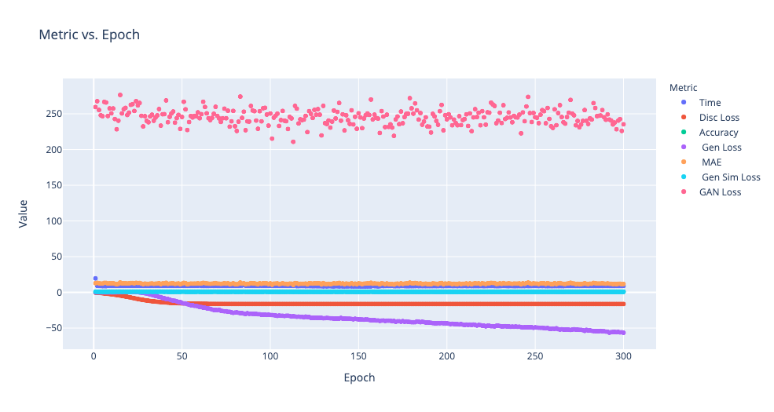
HOW LOSS CHANGE WITH EPOCH?
Notes:
Aman
Indicates the model is doing the right thing and is learning

Slide 18
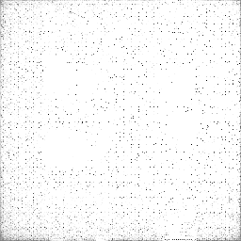
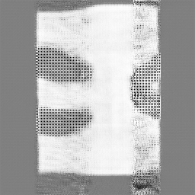
HOW WELL DOES OUR MODEL LEARN?
Ground Truth
Reconstruction
Notes:
Nikhil
Indicates the model is doing the right thing and is learning

Slide 19
NEXT STEPS
05

Slide 20
WHAT FUNCTIONALITY DID WE ADD?
Varying levels of noise: 10%, 20%, none. The noise was generated from a random distribution and added to a fraction of the pixels in the k-space image.
Support for viewing training progress during each epoch: metrics, as well as how the reconstructed image becomes better.
Notes:
Aman
The data was sorted before being assigned to memory. In reality, the lowest key will not be assigned to the lowest memory address. If we did not sort the data, there would be no clear pattern to learn, and the use of a learned index would be diminished. Take a look at this CDF for example. Whats there to learn?

Slide 21
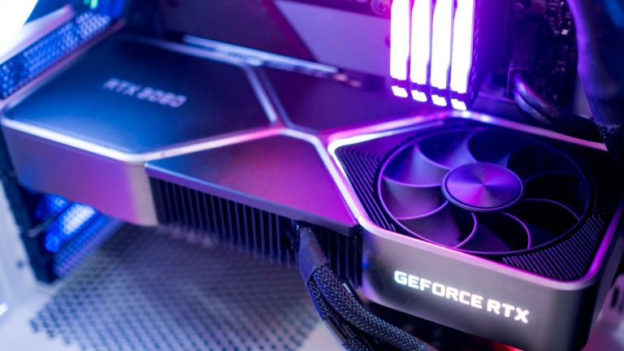
WHAT’S NEXT?
Run model on GPU cluster.
Generate undersampled images with different masks.
Improve similarity metrics to compare generated image with true reconstructed image. This will be incorporated in the loss function of the discriminator.
Test with more datasets.
Notes:
Nikhil
- Tried this with CUDA already but ran into errors with version of CUDA being different from what tensorflow wanted.

Slide 22
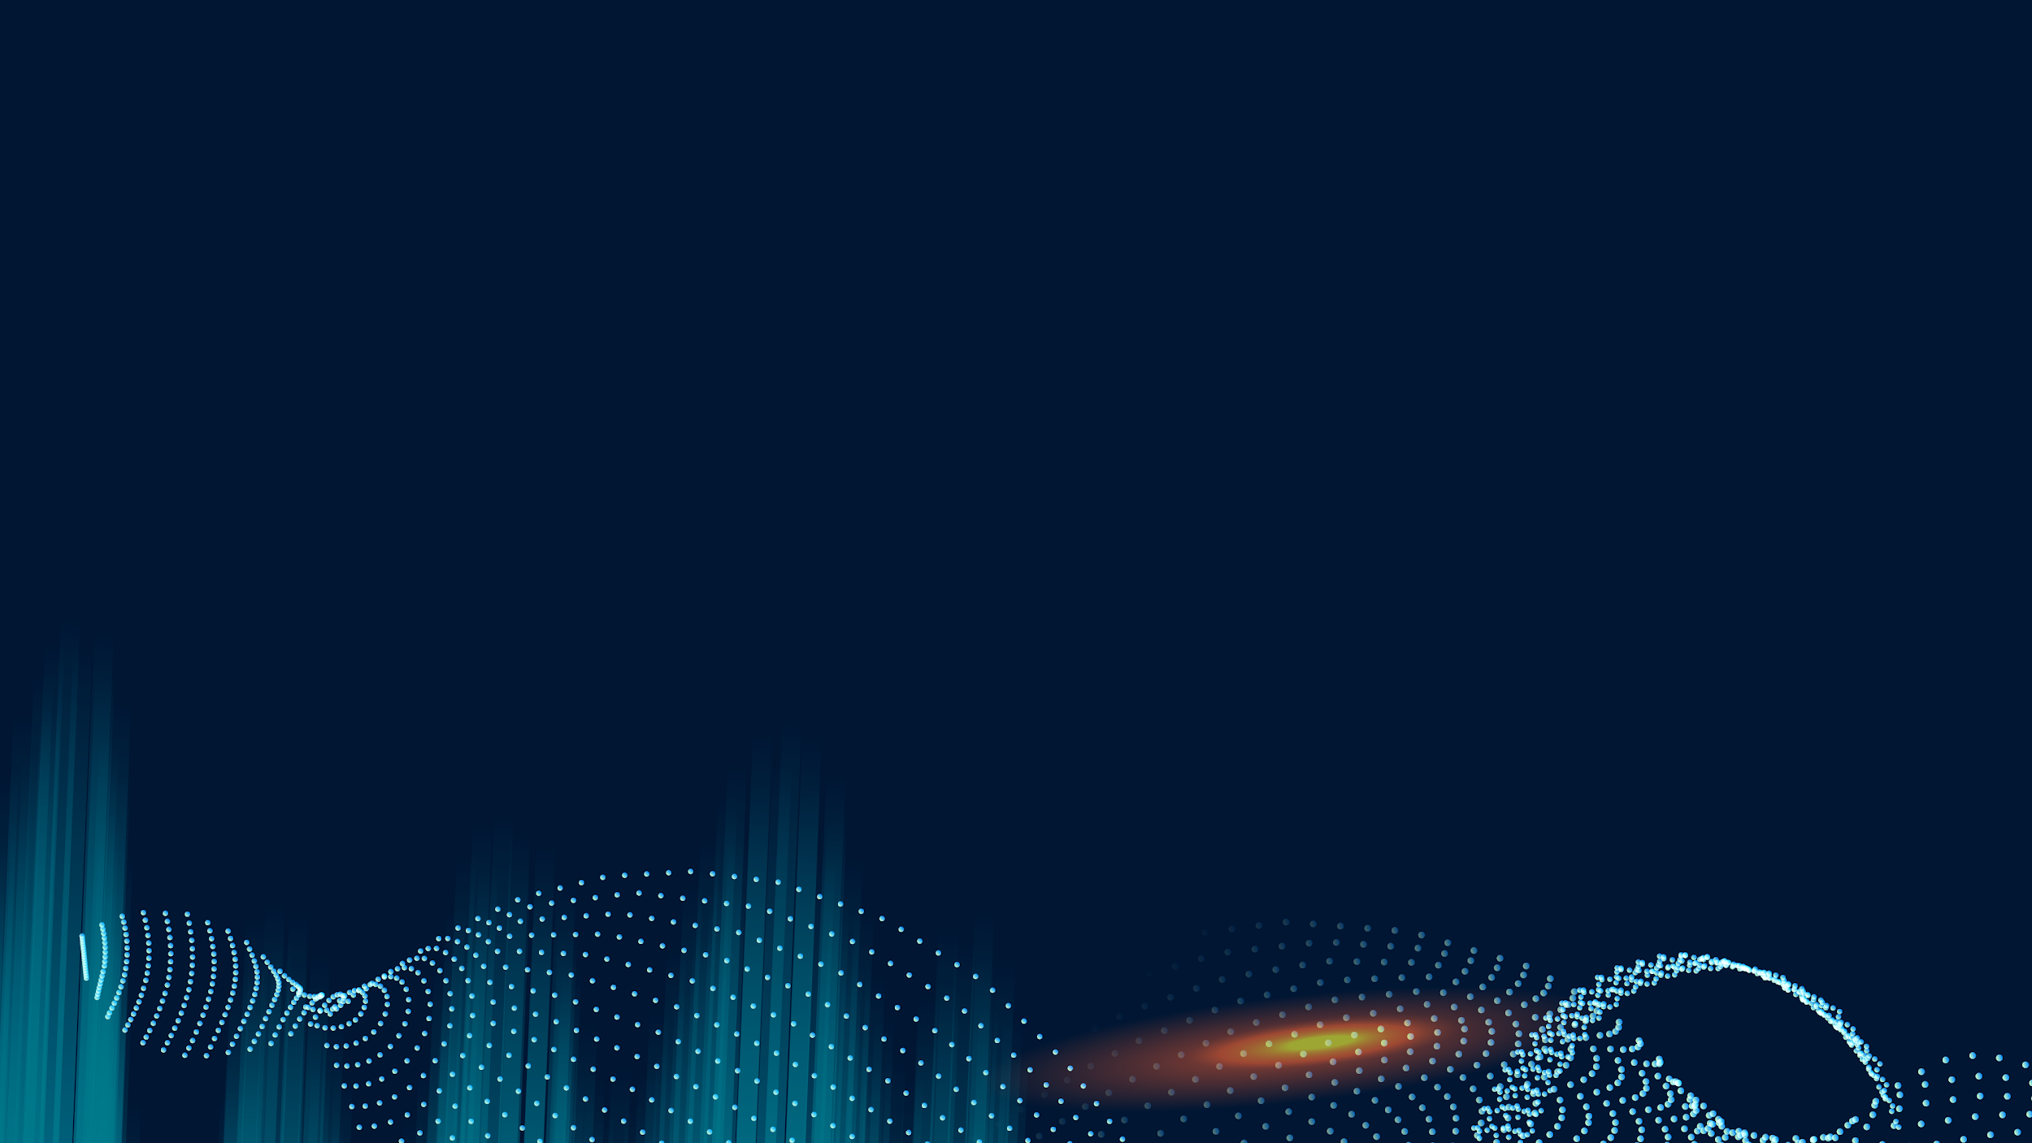
Q & A
Thanks for listening!

